Slide 1
ML.init(0): Dive into PyTorch
A Beginner's Guide to AI & ML Exploration!
Mathilde Verlyck, Max Dang Vu, Edward Ferdian

Slide 2

Objectives
Set up a machine learning project in PyTorch
Train and test a machine learning (ML) model
Run inferences using the trained model

Slide 3
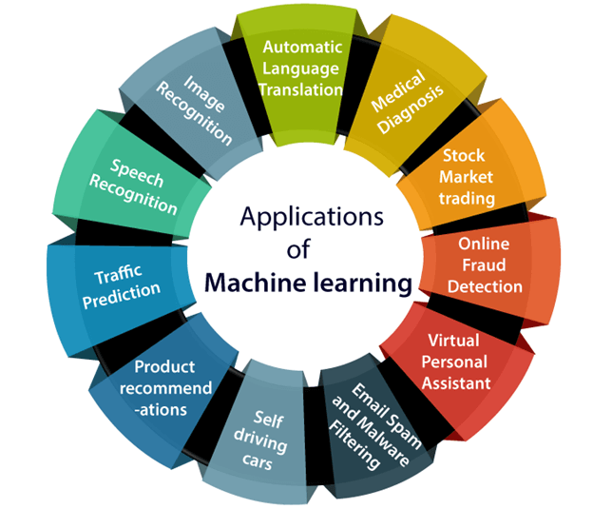
What is PyTorch?
Open-source deep learning library for Python
Mainly used by data scientists for R&D
Tensor computation, great for GPU use
Important modules: autograd, optim, nn
Notes:
Flexible = easy to integrate new data types and algorithm

Slide 4
How does it compare with TensorFlow?
PyTorch | TensorFlow
Pythonic implementation; APIs easier to write, understand and debug Flexible for experimentation, prototyping and data visualisation Rapidly expanding community | Mature, extensive documentation with a large, established community Optimised for production deployment Compatible with existing frameworks and industry standards
Notes:
Flexible = easy to integrate new data types and algorithm

Slide 5


AI research project workflow
1. Pre-process & partition data
2. Create or use an existing ML model
3. Select loss function to compute error
6. Make model inferences
5. Train ML model
4. Select optimizer to improve model learning
← Scan here for code

Slide 6
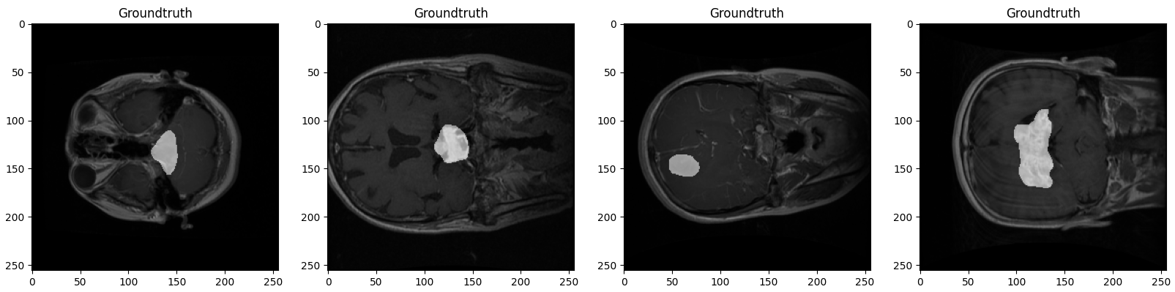
Example: Brain Tumor Segmentation
3064 T1 MRI slices from 233 patients
Three brain tumor types:
Meningioma
Glioma
Pituitary tumor
Cheng (2017). Brain tumor dataset. figshare. Dataset. https://doi.org/10.6084/m9.figshare.1512427.v5
Important necessary libraries
Data -> Get Dataset
Data -> Data visualization

Slide 7
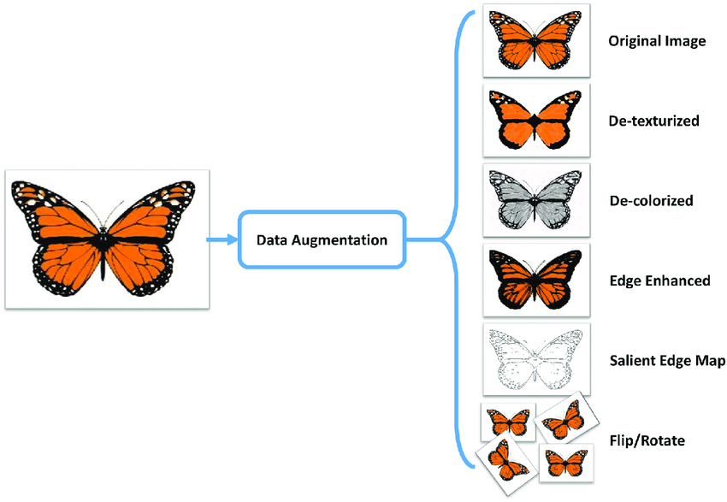
Data
Pre-process data using the Transform class
Numpy arrays → Tensor (torch.from_numpy)
Tensor designed to work with GPU acceleration and backpropagation
Resize image
Can also enlarge dataset by data augmentation
Ahmad et al, PLoS One (2017)
Data -> Dataset class
Data -> Transform class

Slide 8
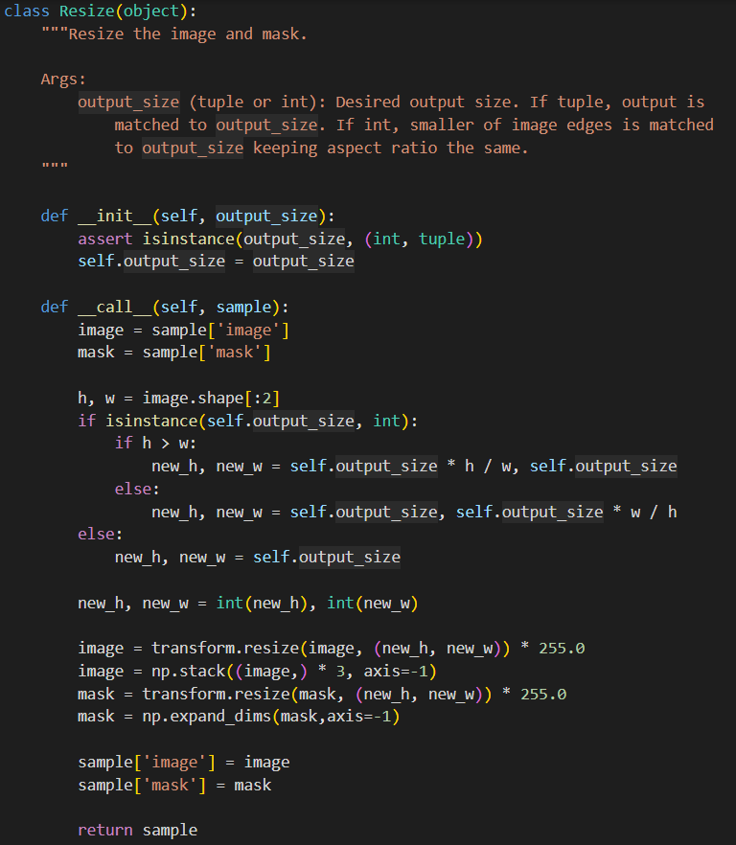
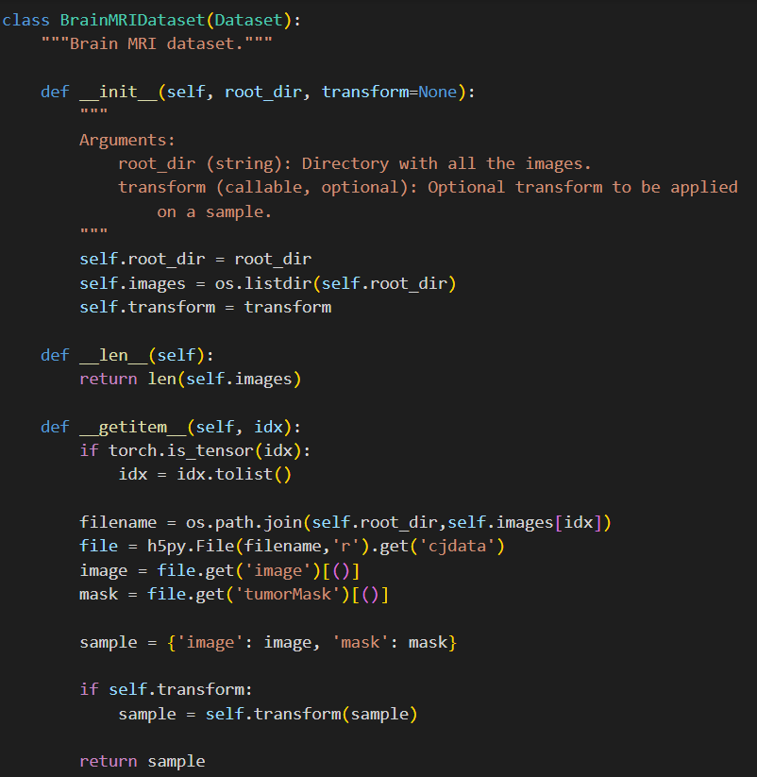
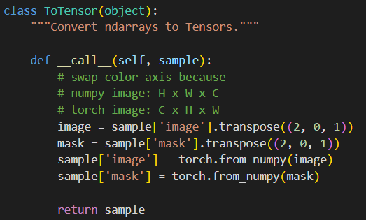
Data

Slide 9
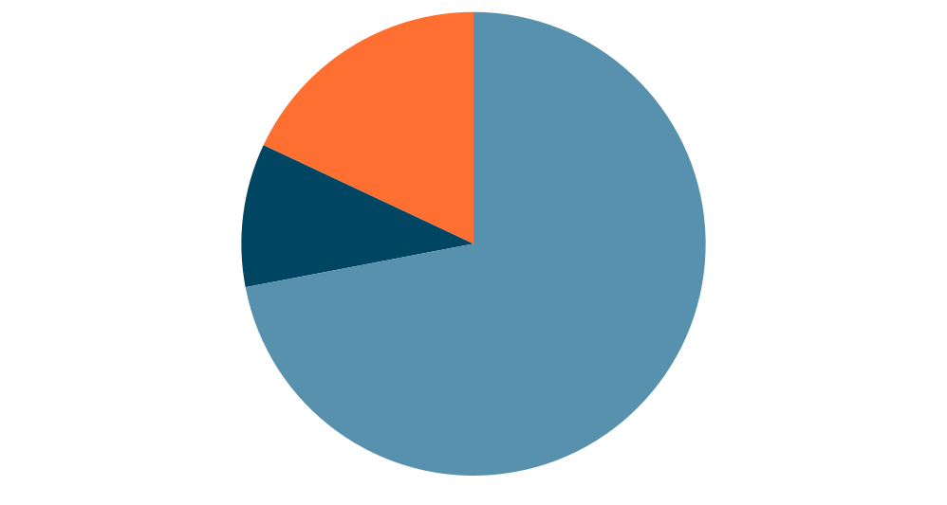
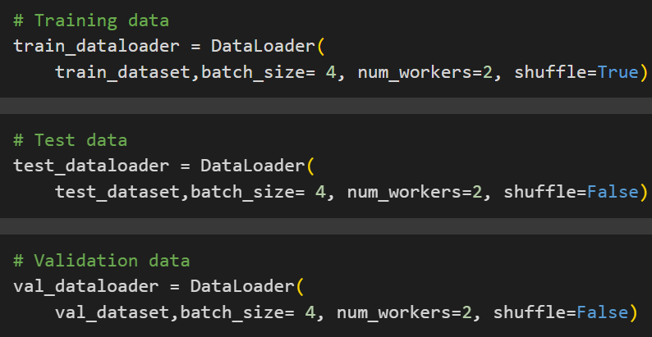
Data
Split dataset and save to respective folders
Load data with DataLoader
Batching: Optimises memory usage
Shuffling: Avoid learning patterns
Parallel loading: Speeds up training
Validation (18%)
Test (10%)
Training (72%)
Data -> Split Data and create Data sets
Data -> Data Loders
Notes:
“While training a model, we typically want to pass samples in “minibatches”, reshuffle the data at every epoch to reduce model overfitting”

Slide 10
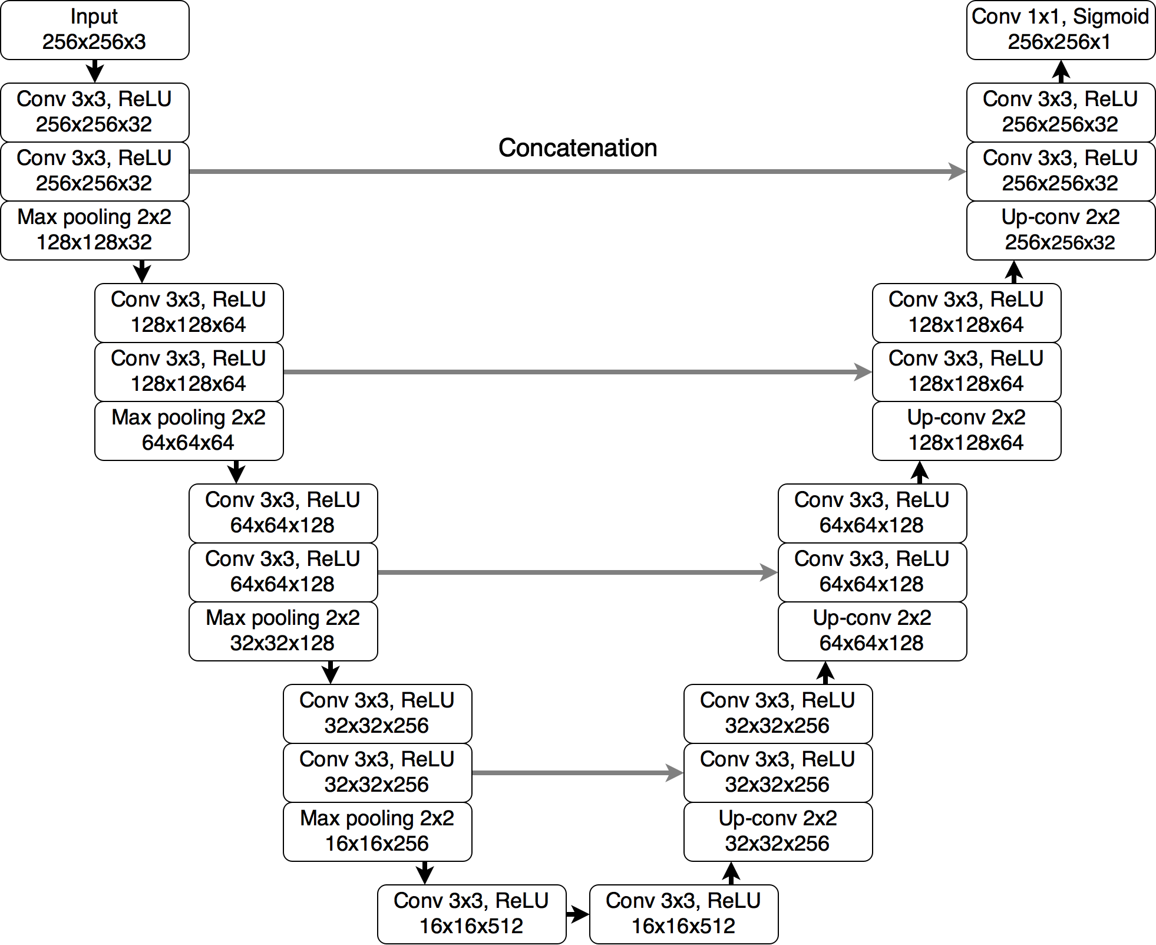
2. Model
Three-channel MRI slice
Single-channel probability map of abnormal regions
U-Net model (developed specifically for segmenting abnormalities from brain MRI)
Buda et al, Computers in Biology and Medicine (2019)
Model

Slide 11
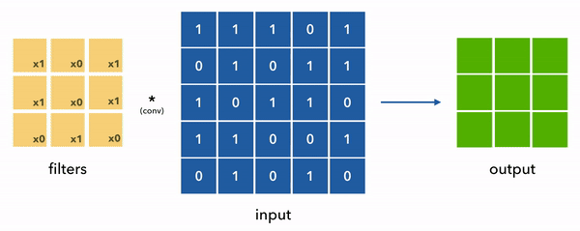
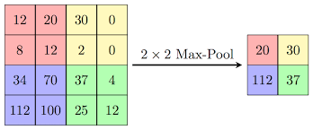
Building blocks
Convolution
Max Pooling

Slide 12
3. Loss
Quantify how well our model predictions perform v.s. ground truth
Model learns by reducing the loss function
Improve model’s predictive ability by minimising the loss function
Choice of loss function is important
Notes:
“Binary Cross-Entropy (BCE) + Soft Dice Loss: Combining binary cross-entropy (BCE) and soft Dice loss offers a balanced approach to image segmentation. BCE loss measures the pixel-wise similarity between the predicted and target masks, while the soft Dice loss ensures accurate boundary localization. The combination of these loss functions is effective in achieving both accurate object localization and overall segmentation accuracy.“

Slide 13
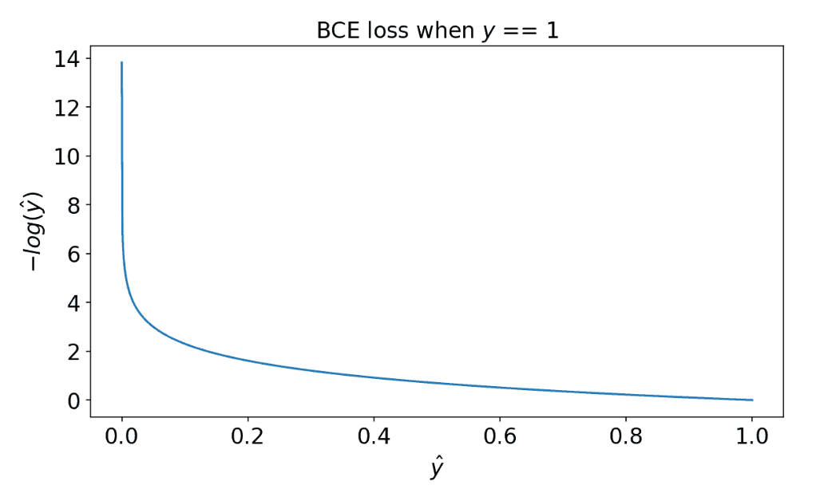
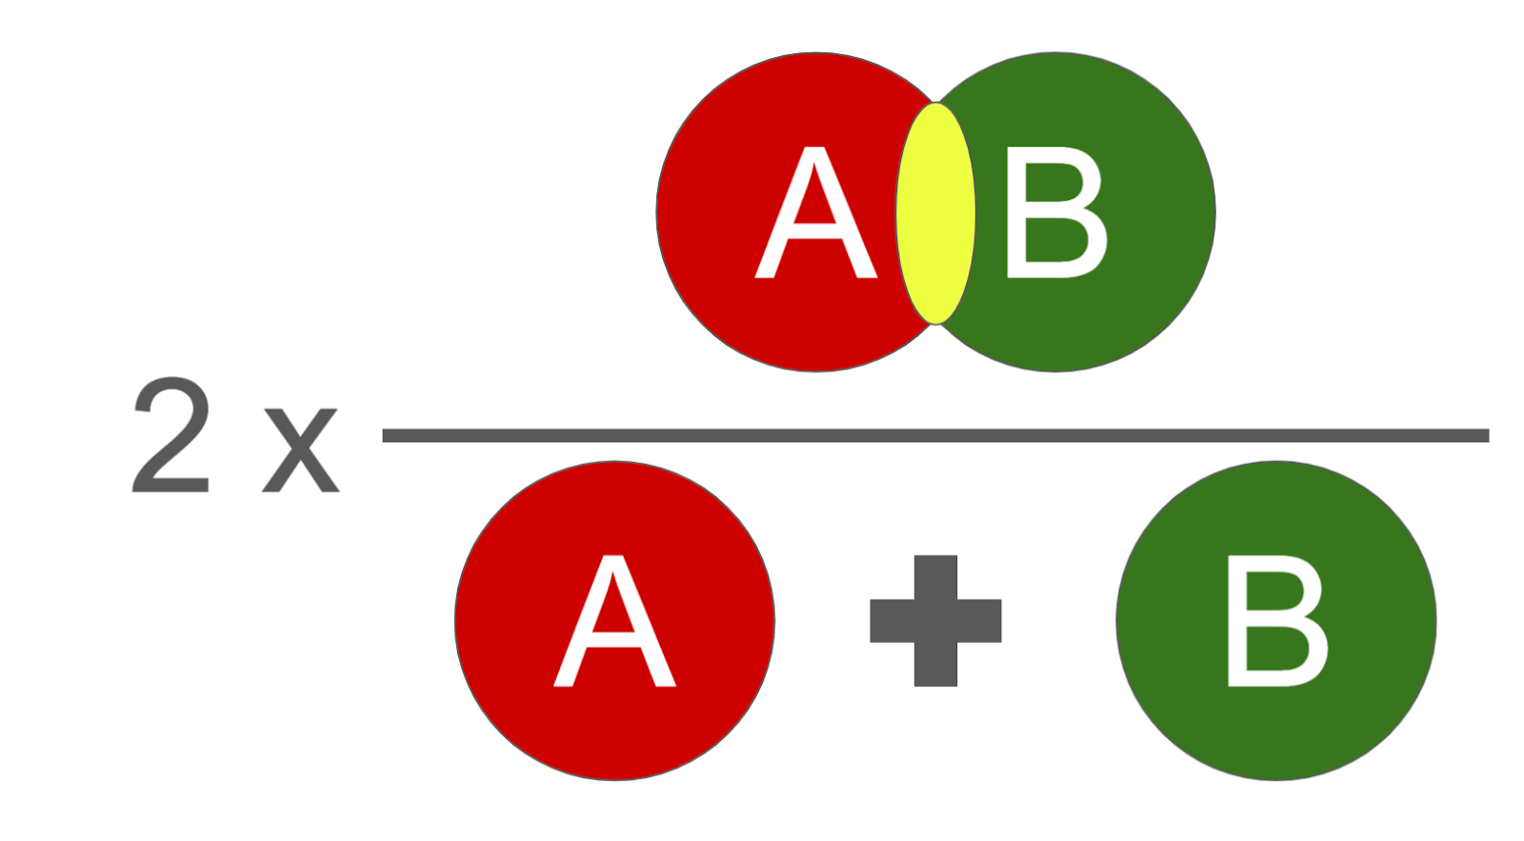
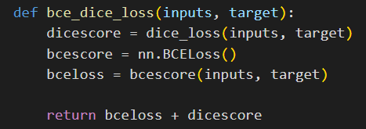
3. Loss
DICE score
Accurate boundary localisation
Binary Cross-Entropy (BCE)
Measures pixel-wise similarity between predicted & target mask
BCE Dice Loss
Accurate object localisation & overall segmentation accuracy
A = Prediction B = Ground truth (target)
Area of overlap
Total area
DICE score
Balanced approach for image segmentation
Loss
Notes:
“Binary Cross-Entropy (BCE) + Soft Dice Loss: Combining binary cross-entropy (BCE) and soft Dice loss offers a balanced approach to image segmentation. BCE loss measures the pixel-wise similarity between the predicted and target masks, while the soft Dice loss ensures accurate boundary localization. The combination of these loss functions is effective in achieving both accurate object localization and overall segmentation accuracy.“

Slide 14
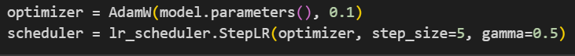
4. Optimizer
Optimizer updates the value of weights using the gradient from loss.backward to minimize loss
Gradient = change in loss function w.r.t. weight of model
Gradient → 0: minimise loss, achieve optimal model configuration
Lr scheduler to update learning rate depending on the training behaviour
Optimizer

Slide 15

5. Training
Training loop:
Train
Predict
Compute loss
Optimize
Validate
Predict
Compute loss
Save best model
Adjust learning rate
Repeat
Training
Notes:
Mention run for 5 epochs, realistically you want to do more than that.

Slide 16
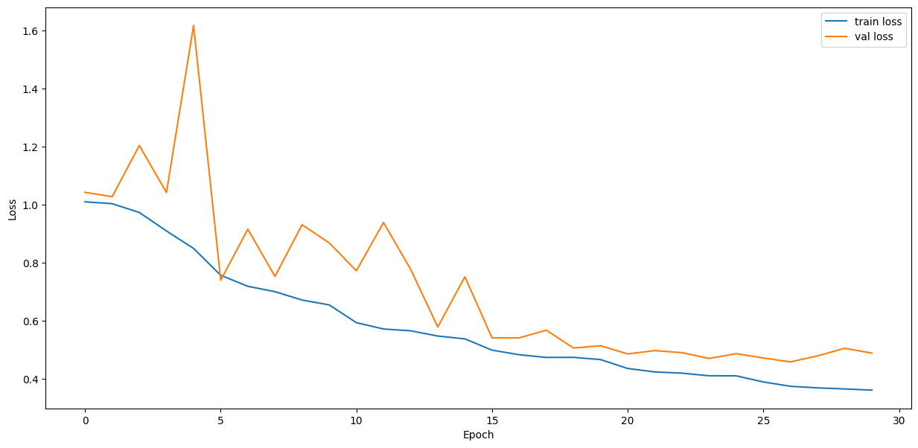
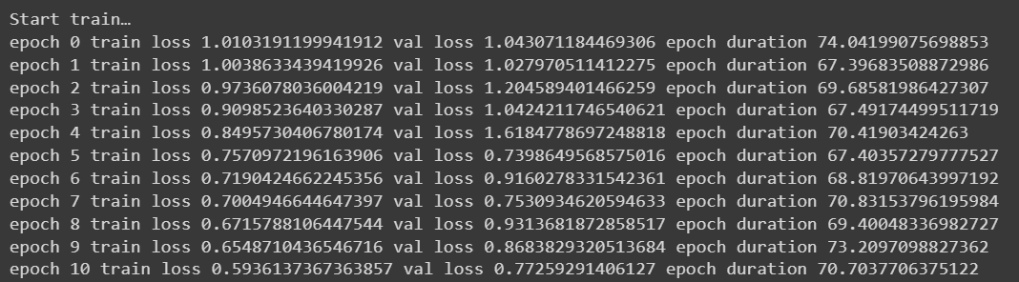
5. Training

Slide 17
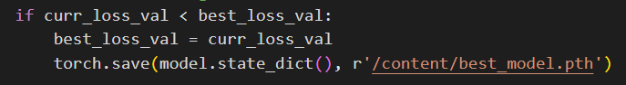
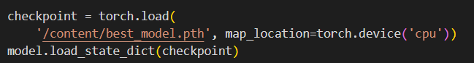
6. Inference
Save & load models
Use best model weights to segment tumours (test set)
Inference -> Load best model weights
Inference -> Visualization
Inference -> Accuracy

Slide 18
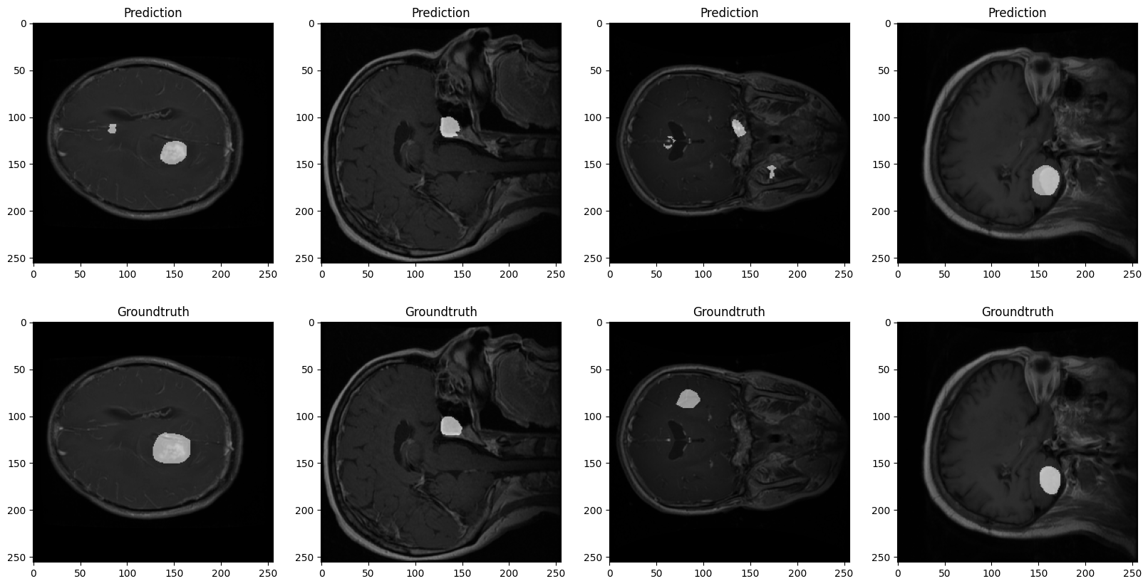
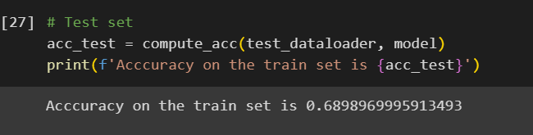
6. Inference
Save & load models
Use best model weights to segment tumours (test set)
Visualize predicted and ground truth images
Compute model accuracy using test cases
Inference -> Load best model weights
Inference -> Visualization
Inference -> Accuracy

Slide 19
Summary
Learnt how to set up a machine learning project in PyTorch
Trained and tested a machine learning model to perform brain tumour segmentation
Performed inferences with the trained model
Now, let’s head over to the code!

Slide 20
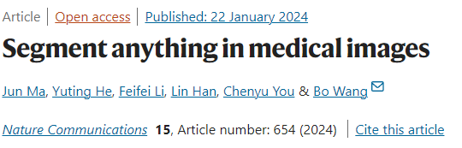
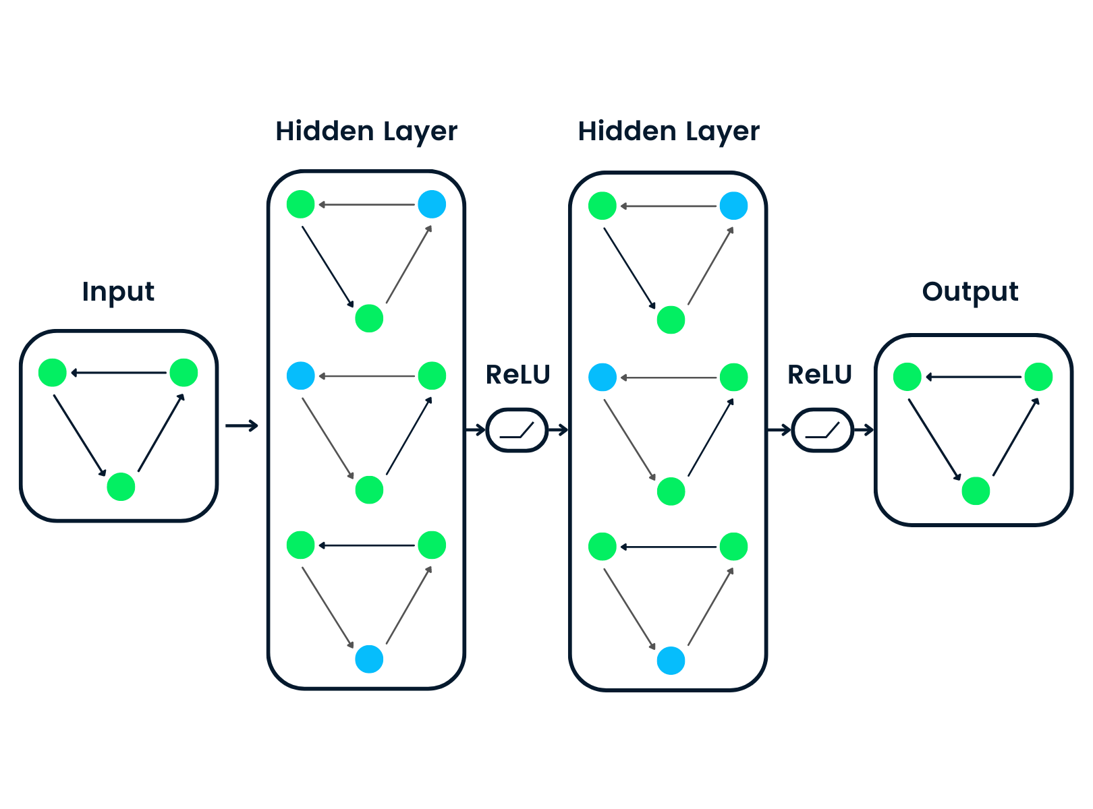
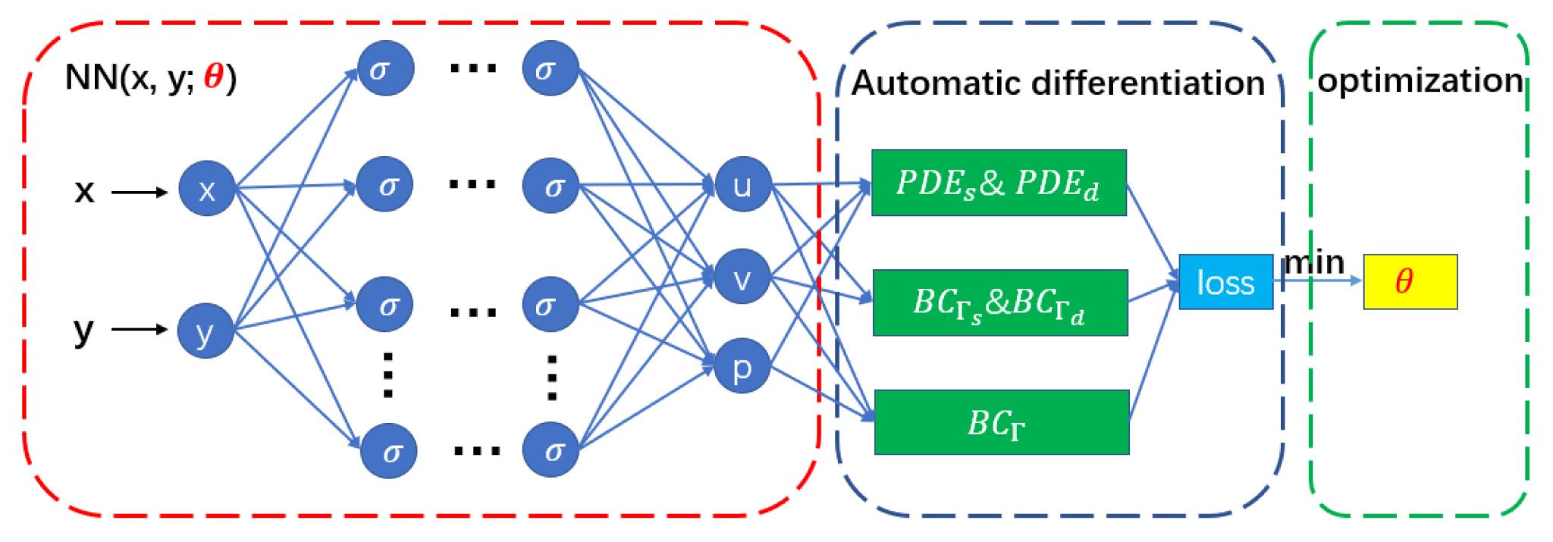
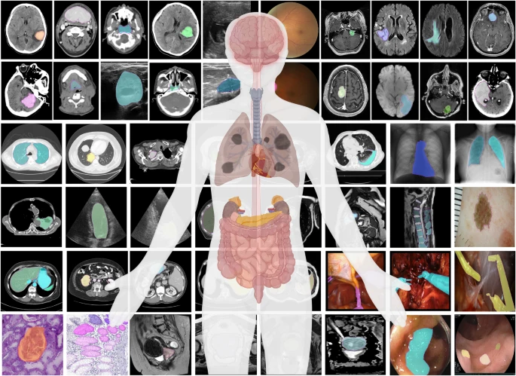
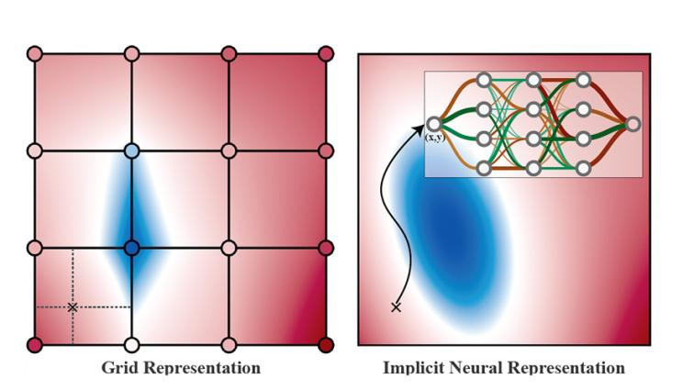

What’s next?
Graph Convolution Network
Physics-Informed Neural Networks (PINNs)
Diffusion Models
Neural Implicit Representation (NIR)

Slide 21








ML.init() team
Gonzalo Maso Talou
Edward Ferdian
Alireza Farrokhi Nia
Jiantao Shen
Mathilde Verlyck
Matthew French
Max
Dang Vu
Mostafa Papen
If you’re interested to use ML in your work, or are just curious:
feel free to reach out for a chat!

